Slide 1


AI-Powered Data Analyst Assistant
Azmeera Manjula
MBA – Business Analytics

Slide 2



STUDIO SHODWE
PROBLEM STATEMENT
Businesses face delays in data analysis
Due to dependency on technical
teams for SQL queries and dashboards.
Non-technical users struggle to
extract insights from data quickly.

Slide 3

SOLUTION
DEVELOPED AN AI-POWERED ASSISTANT THAT:
1
Converts natural language into SQL queries
2
Converts natural language into SQL queries
3
Generates insights automatically
4
Visualizes data using charts

Slide 4


FEATURES
- Natural Language Query Input
- Auto SQL Generation
- Data Analysis using BigQuery
- Insight Generation
- Data Visualization (Charts)

Slide 5
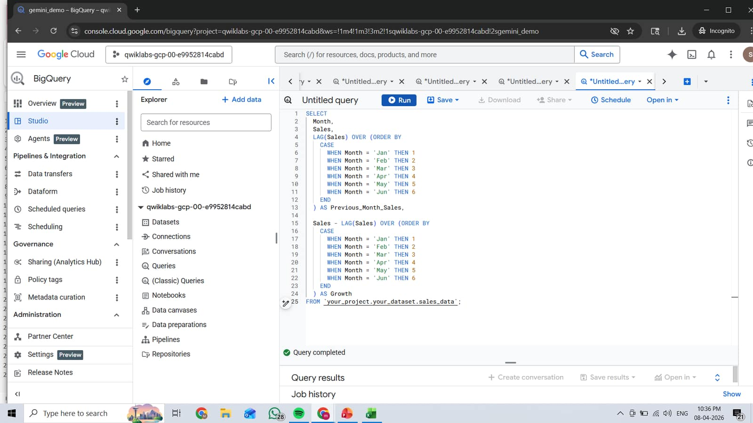
SQL QUERY
PROCESS FLOW
User Query → AI Processing → SQL Query → BigQuery → Insights → Visualization

Slide 6
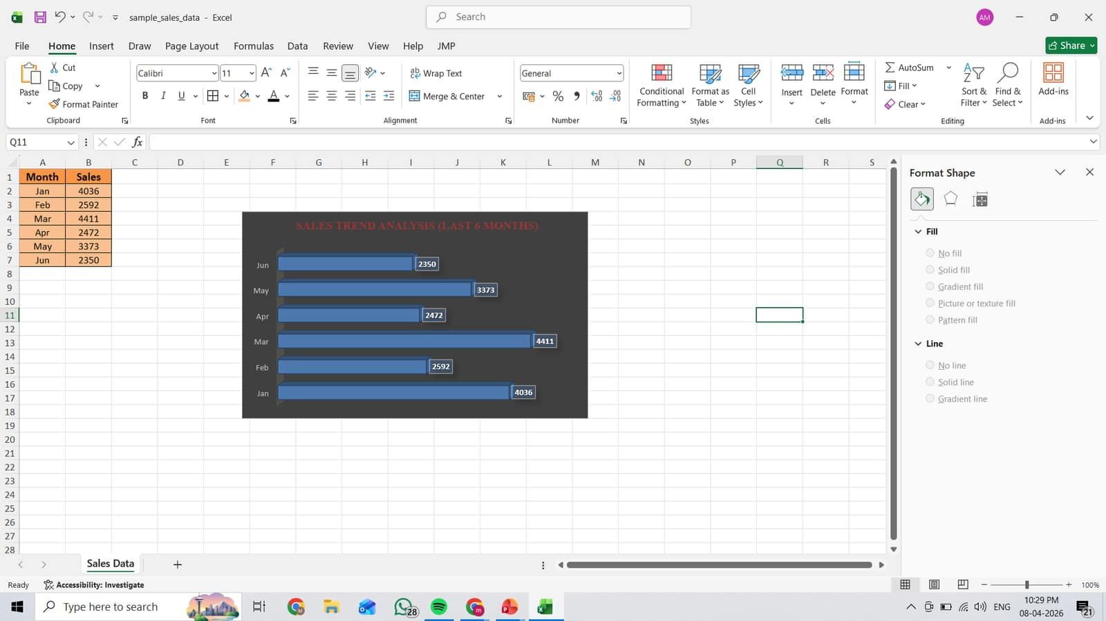
Sales Trend
Analysis
Visualization
(Last 6 Months)

Slide 7

INSIGHTS
- Sales peaked in March (4411), indicating the highest demand
- Decline observed in April and June
- February shows lower performance compared to January
- Overall fluctuating trend with growth opportunities
- Business should focus on improving consistency

Slide 8

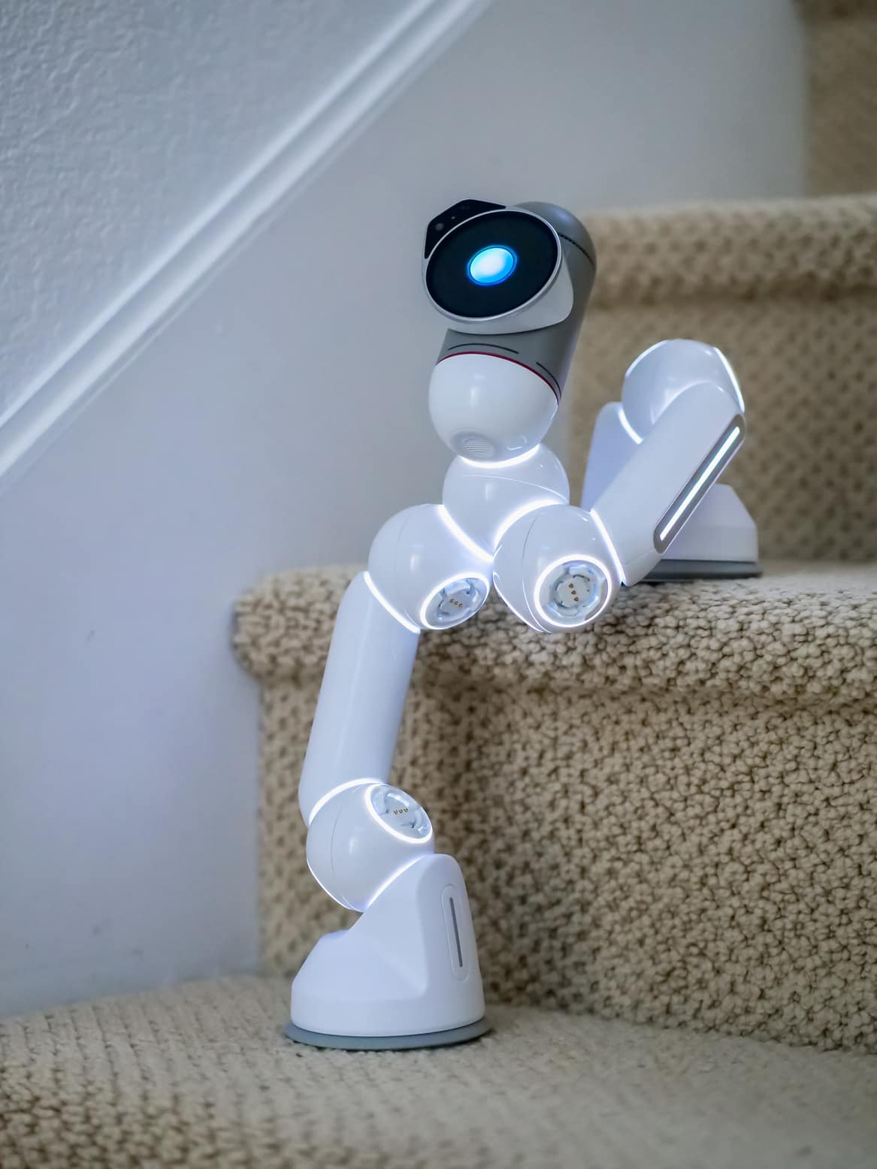

CONTACT US
6305088117
MANJULAAZMEERA2@GMAIL.COM

Slide 9

CONCLUSION
This solution enables faster and easier data analysis using AI.
It reduces dependency on technical teams and helps businesses make quick decisions.

Slide 10

THANK YOU

